Slide 1

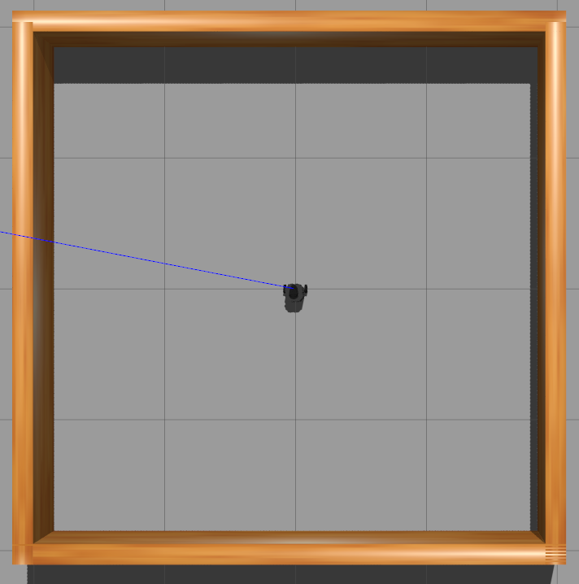
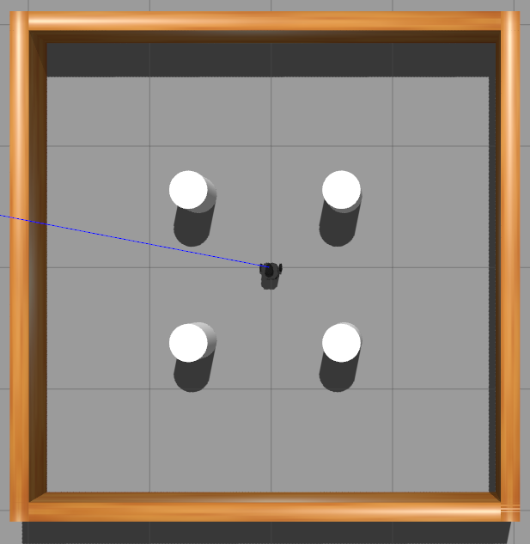
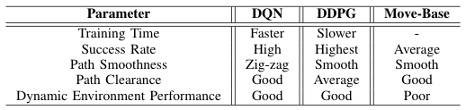
RoboNav: Robot Navigation in Dynamic Environments using Deep Reinforcement Learning
Group 7: Abhishek Jain, Kavit Shah, Kenechukwu C. Mbanisi, Sanjeev Kannan
Advisor: Prof. Yanhua Li
Problem Statement Navigating a Turtlebot to a goal destination in a closed environment with static and moving obstacles
Neural Net Architecture
DQN
1 x Input Layer
2 x Fully Connected Layers
1 x Output Layer
DDPG
1 x Input Layer
1 Batch Normalization Layer
3 x Fully Connected Layers
1 x output Layer
Trained Models
Observation Space
Laser scan data, Positon, Heading
Action Space
Linear Velocity, Angular Velocity
Rewards
Based on distance, and heading towards goal
Stages / Training Environments:
Empty Environment With Static Obstacles
Moving Obstacles Static + Moving Obstacles
Results
References
[1] http://wiki.ros.org/move_base
[2] Durrant-Whyte, Hugh, and Tim Bailey. ”Simultaneous localization and mapping: part I.” IEEE robotics & automation magazine 13.2 (2006): 99-110
[3]https://www.researchgate.net/figure/From-a-modular-pipeline-to-a-perception-planning-deep-neural-network-approach-for_fig1_334049155
[4] Liu, L., Dugas, D., et. al. Robot Navigation in Crowded EnvironmentsUsing Deep Reinforcement Learning. Presented at IROS 2020

